Slide 1
OUT OF THE BOX
HOW TO USE THE
SYSTEM
This presentation is for new Techs who never visit the application before.

Slide 2
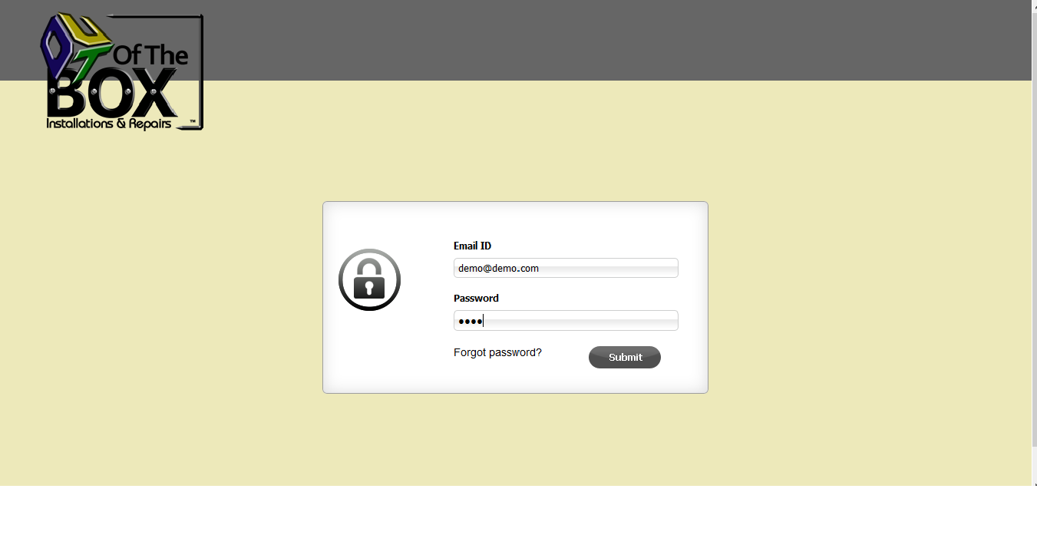
Login screen require valid Email ID and Password.
Valid Email ID and Password can be collect from system administrator . Using this credentials one can login to the application.

Slide 3
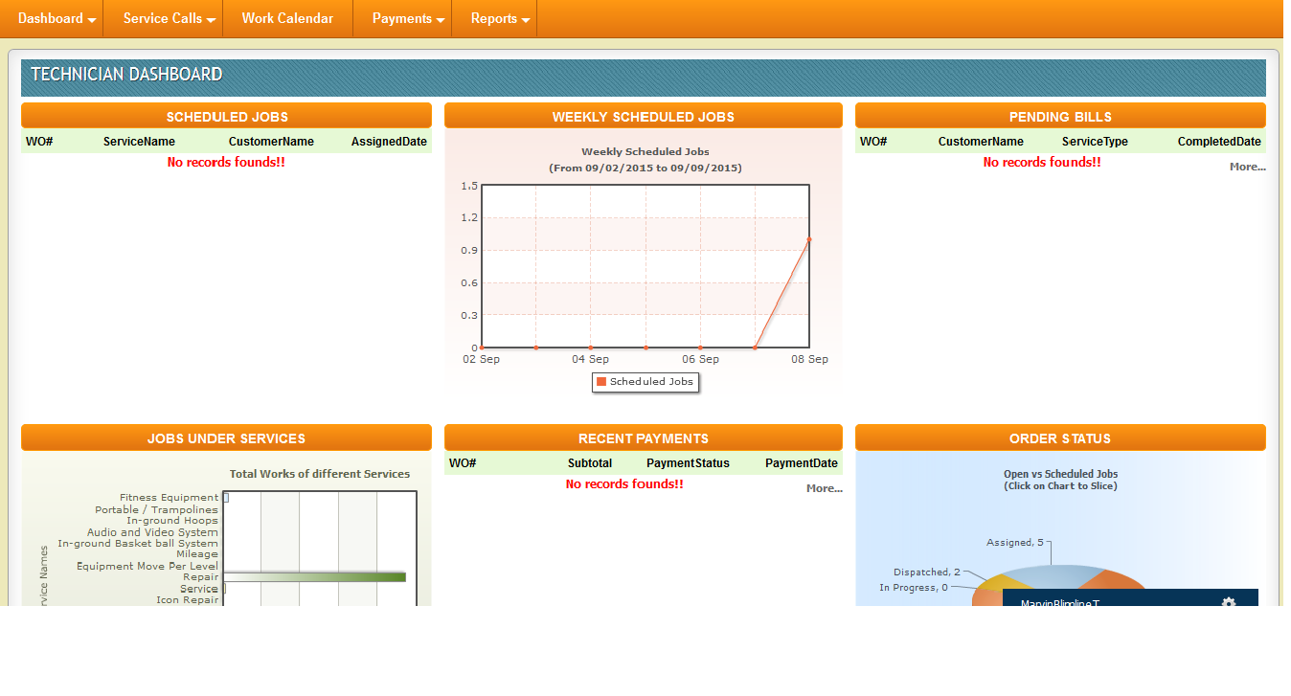
Dashboard shows scheduled jobs ,weekly schedule jobs with pending bills and payments.
Dashboard is the overall presentation of system where techs can found instant statistical knowledge about the application.

Slide 4
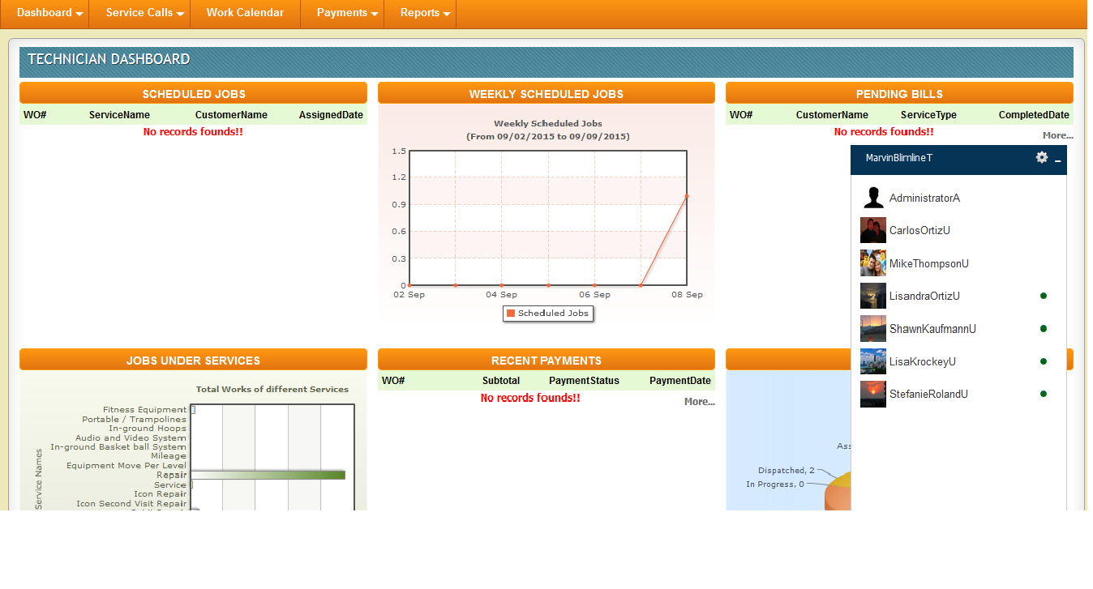
Chart window to communicate with admin users anytime
Chart window shows online users with green button.
This is an extra facility to every users so that they can send private messages to the admin users.

Slide 5
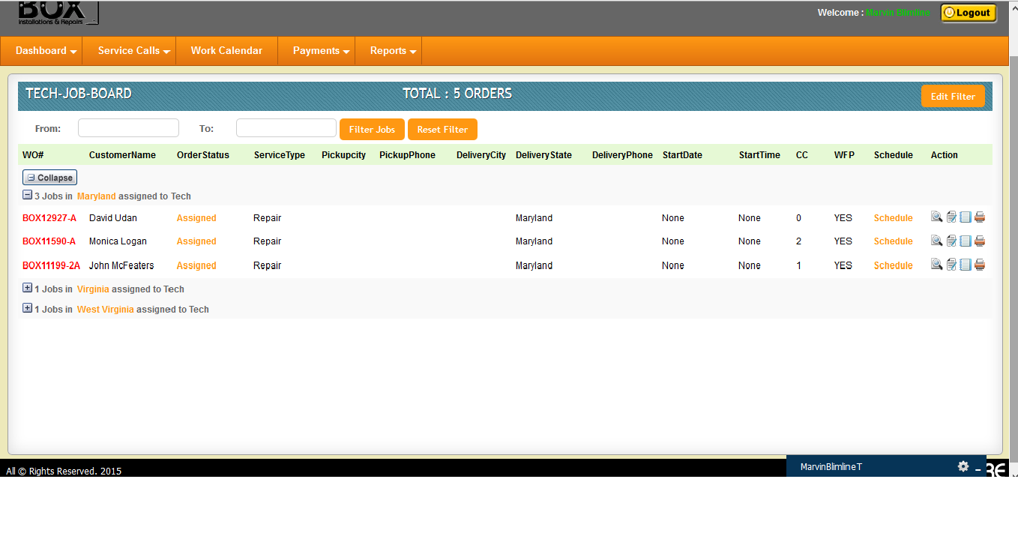
Tech Job Board. The Important page for Tech where all operations can be done.
More filter options can be view on click this button
Jobs can be filter using schedule dates
Tech Job Board displays all the Assigned jobs of the current date. Techs can Schedule Orders, Set Work Order Status, View Work Order and Give Notes/Comments.

Slide 6
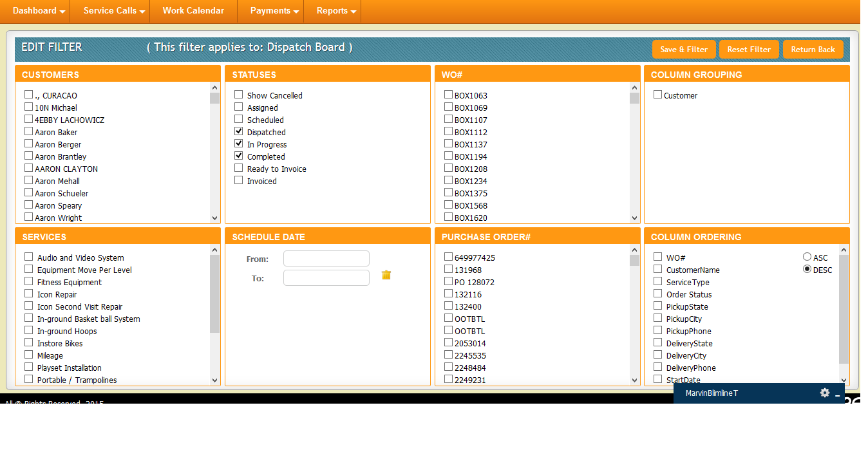
Edit Filter Screen helps in advance job search. Filter Result will display in Tech Job Board.
Advance filter options like Customer, Status , WO#, Services, Schedule Date, Purchase Orders, Column grouping are present above. By checking the options you have to click on “Save & Filter “ button.

Slide 7
Know your functional buttons and links to manipulate work order.
View work status given
Schedule the jobs
View work order
View the work order.
Write work order notes
Change work order status
Print work order.
This is the gateway of system. Important functional links are present to view the work order , schedule the order and change status in between the work progress.

Slide 8
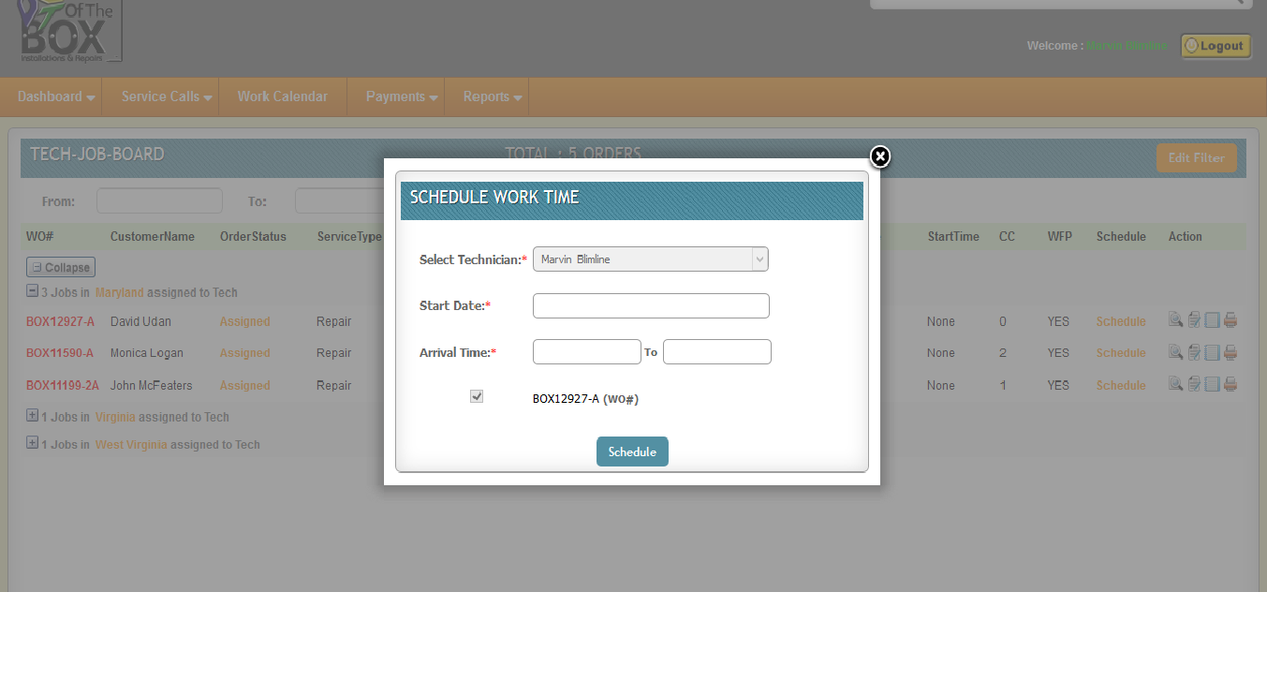
Schedule work time window helps to set work order start time. Techs can fill expected start date with arrival time.
This window will appear on click “Schedule” link from Tech Job Board page.

Slide 9
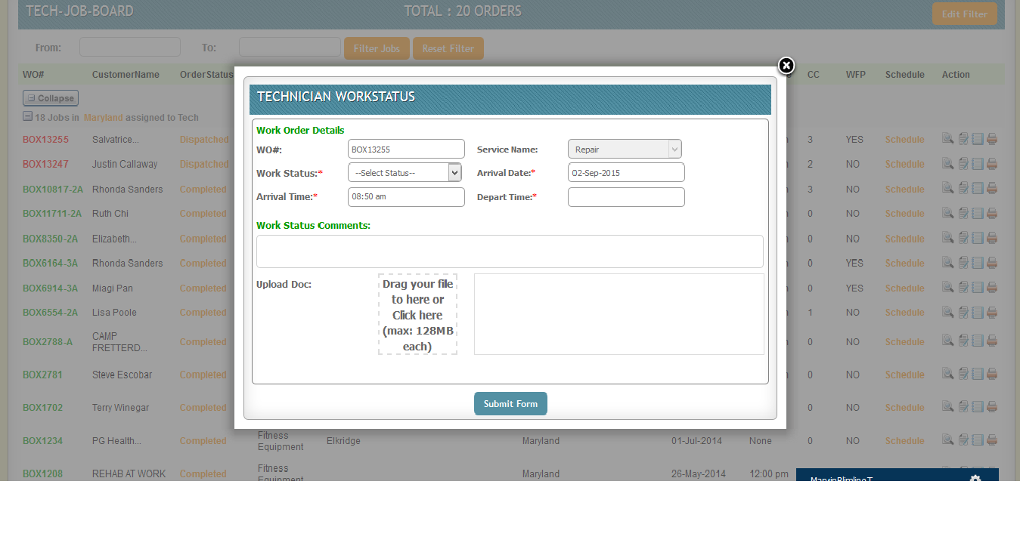
Technician work status window helps to change work status and upload images or docs.
This window will appear on click “Set Work Status Icon” from Tech Job Board.

Slide 10
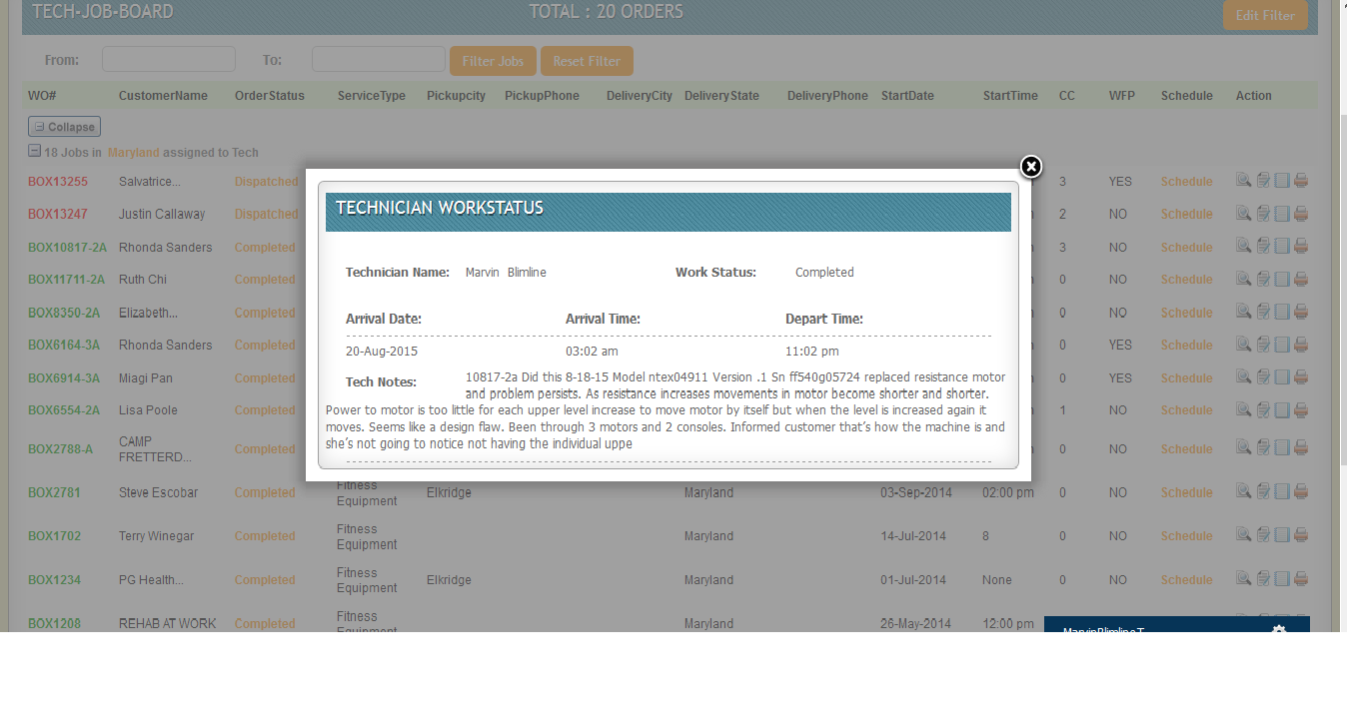
This is another work status window helps to know what is the current status of work.
This window will appear on click coloured order status. i.e Dispatched, In progress, Completed, Invoiced etc.

Slide 11
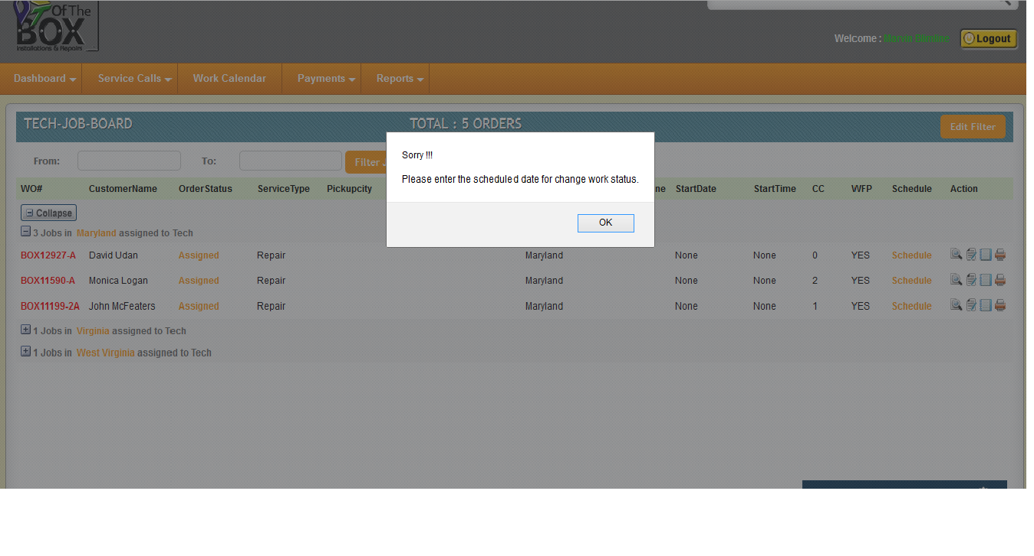
This notification helps to enter schedule date before trying to change work status.
This notification will appear if some tech click on “Set Work Status” icon before schedule the job previously.

Slide 12
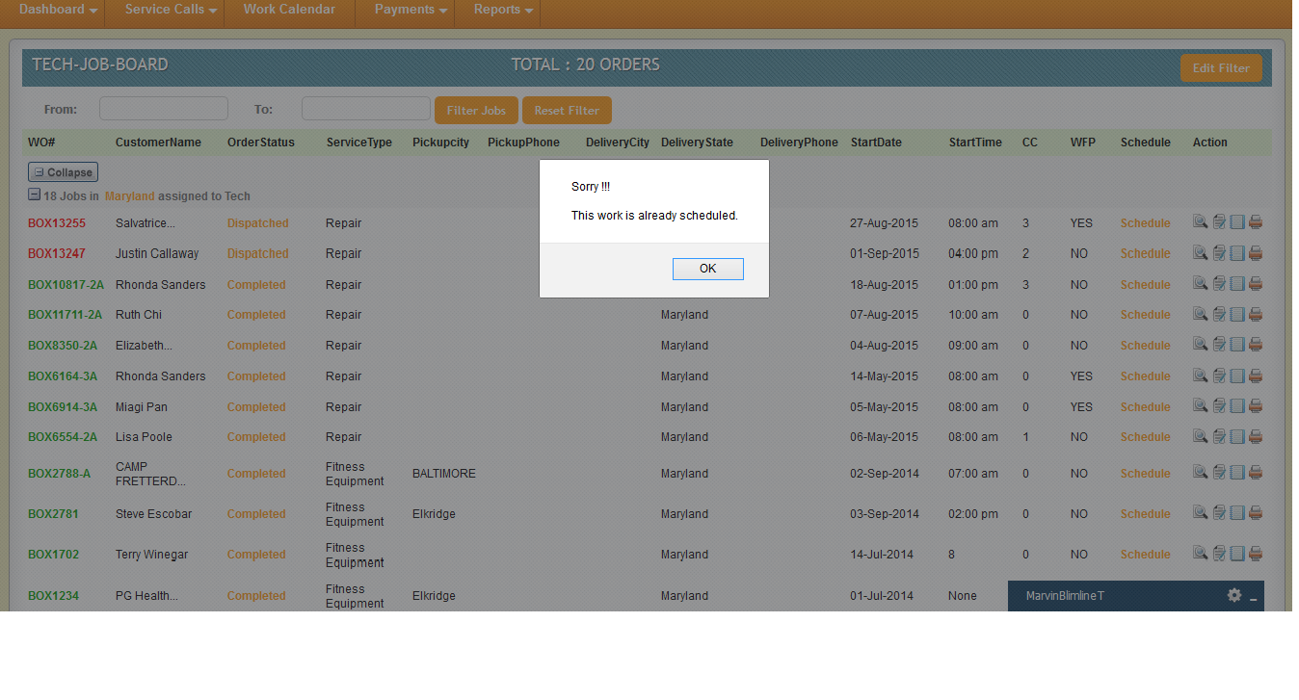
This notification helps to know tech about the schedule of the job.
When the work order is changed to Dispatched or In progress or Completed or Invoiced then if the techs click on “scheduled” option again then this warning message will be displayed.

Slide 13
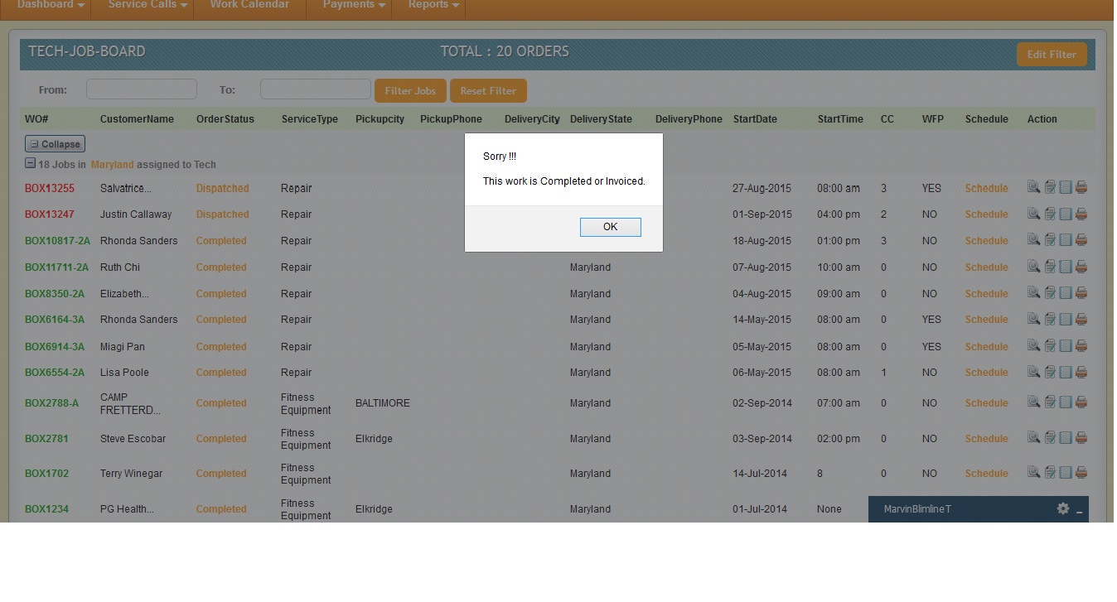
This notification helps tech to know the work order is completed or invoiced.
When the work order is changed to Dispatched or In progress or Completed or Invoiced then if the techs click on Set Work Status icon(book icon) again then this below warning message will be displayed.

Slide 14
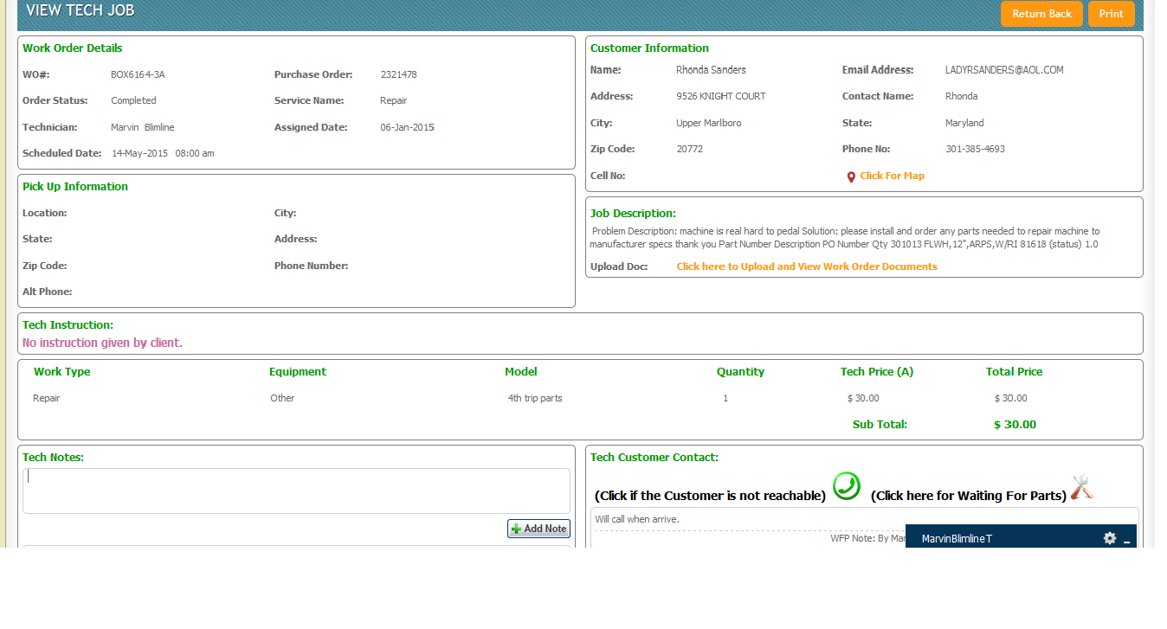
Job View page where Tech can view details of the work order. Important page for techs.
View customer location map.
View uploaded docs .
Click if the customer is not reachable.
Click for waiting parts.
Add notes to the work order.
This is one important page as techs can give Notes for the work order, Click for Map, Click for Customer contact icon and Click for waiting for parts option. One more thing is uploaded documents can be viewed and downloaded by clicking “Click here to upload and view work order documents”. If extra image or doc is needed to upload then can be possible.

Slide 15
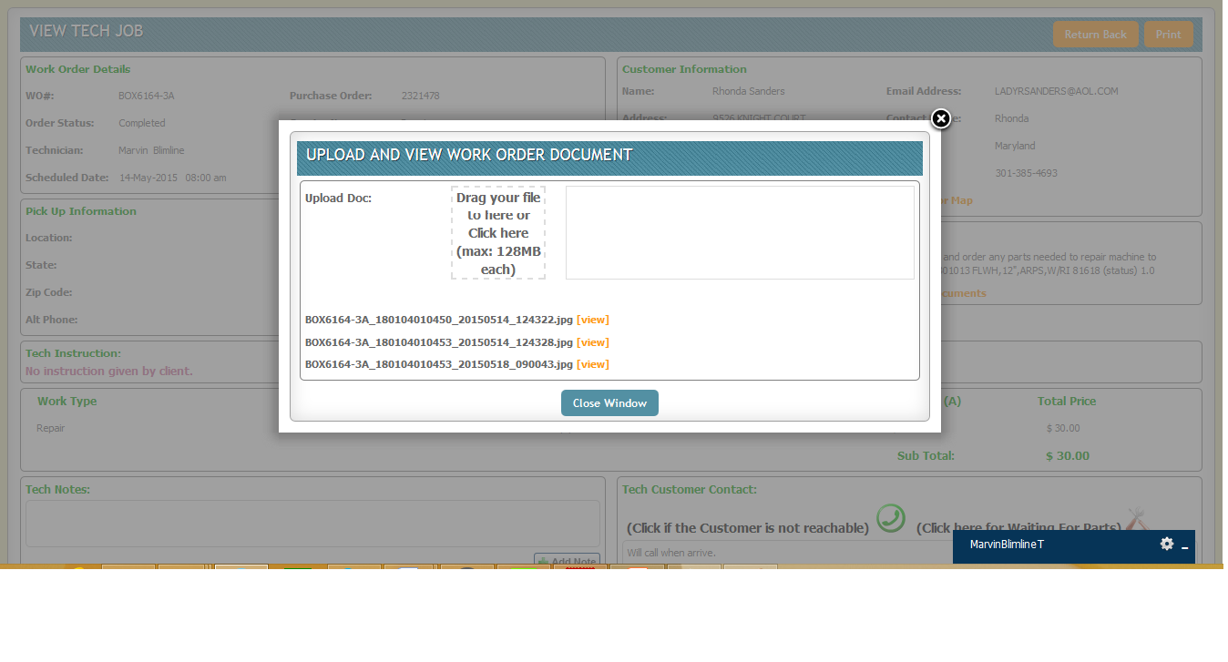
Upload and view work order docs window helps to view/upload docs.
If the techs click on “Click here to Upload and View work order documents” link then this window will appear. Here techs can download or view the uploaded documents. If extra image or document is left to upload then simply click on the image upload area and wait for complete the progress bar, then close the window

Slide 16
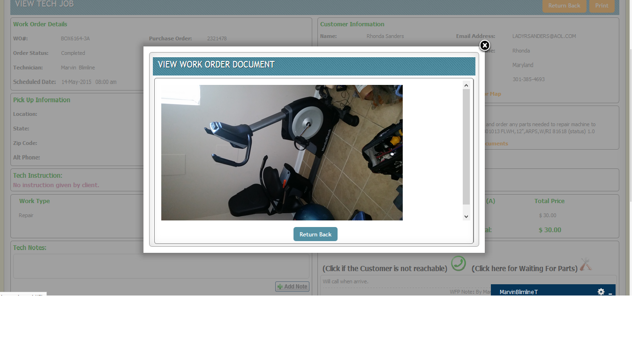
This window helps to view uploaded image/docs to the work order.
This window is to view the uploaded document online. If the techs click on [view] option (orange coloured) then the document will be viewed in place of the previous window.

Slide 17
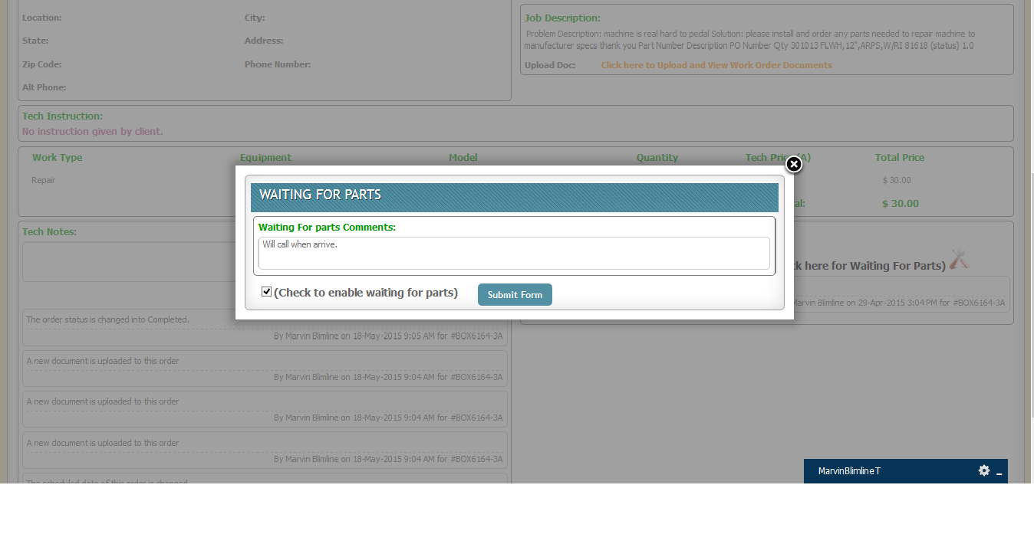
This window is for waiting for parts. Techs can write some text for clients.
If techs click on the waiting for parts icon (tool icon) then this window will appear where reason for waiting for parts can be given. If check box is checked then the waiting for parts is active otherwise the waiting for parts is now avoided for that work order.

Slide 18
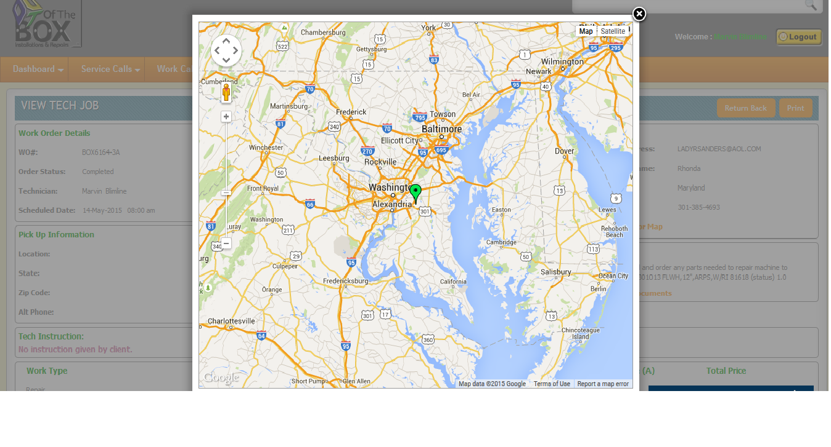
Customer Location Map window helps to Techs easily find out the work location.
This window is Viewing Customer Location Map. On click Marker (Green color Marker) techs can easily locate the area of the customer where actual work is going to be done.

